Slide 1

YouTube Data Analysis using MapReduce on Hadoop
Submitted TO: AsHutosh Shankadhar SIR
Submitted By:
NAMAN MAHESHWARI (181500411)
VISHAL SHARMA (181500805)
MAHESH SHARMA (181500358)

Slide 2

Abstract
YouTube, owned by Google, a video streaming site which has billions of users and 400 hours of videos are being uploaded every minute. Almost billions of videos are watched on YouTube every single day, generating mammoth amount of data daily.
Since YouTube data is generally in unstructured form, there is an increased demand to store, process and analyse such real time Big Data.
We have used MapReduce framework of Hadoop for processing and analysing real time YouTube datasets. It will help in discovering how competitors are performing on YouTube. One can easily identify what content works best on YouTube. These analytical data can be represented in demographic form which can be used by individuals and organizations for making immediate actionable decisions so as to gain competitive advantages.

Slide 3

What is Big Data?
Wikipedia defines Big Data as "a collection of data sets so large and complex that it becomes difficult to process using the available database management tools.
The challenges include how to capture, curate, store, search, share, analyze and visualize Big Data.
In today's environment, we have access to more types of data. These data sources include online transactions, social networking activities, mobile device services, internet gaming etc.
Big Data is a collection of data sets that are large and complex in nature. They constitute both structured and unstructured data that grow large so fast that they are not manageable by traditional relational database systems .

Slide 4
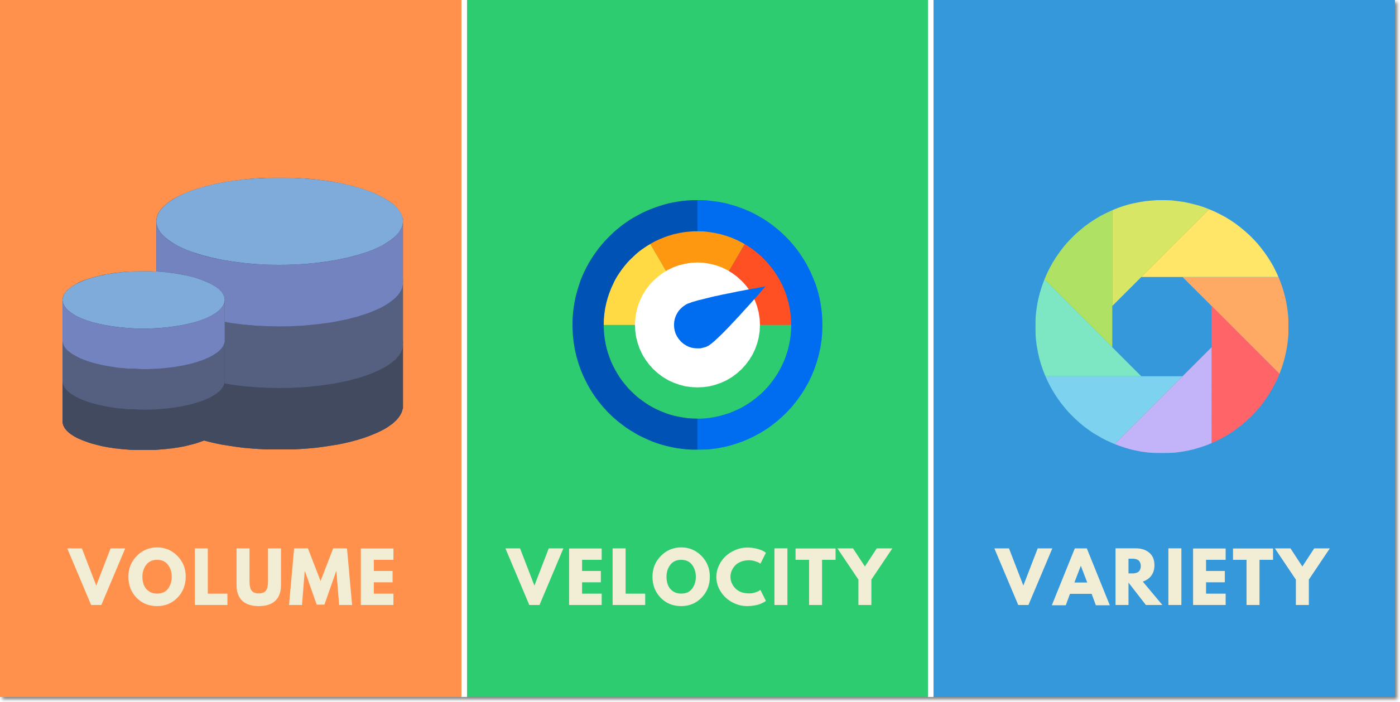
What is Big Data?
Big Data is defined as any kind of data source that has at least three shared characteristics:
Extremely large Volumes of data
Extremely high Velocity of data
Extremely wide Variety of data

Slide 5
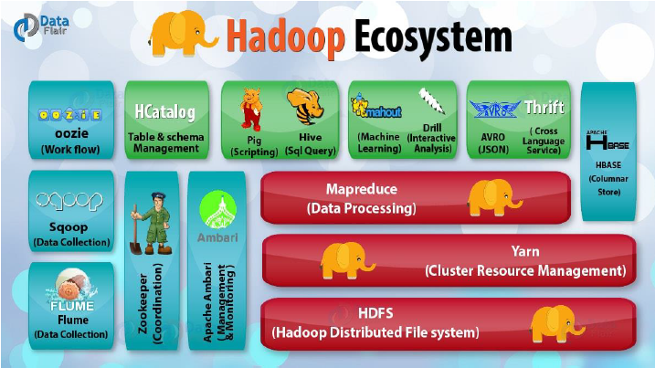
What is Hadoop ?
It is a framework for storing data on large clusters and for storing data on large clusters
Hadoop consists of two main components
A distributed processing framework named MapReduce (which is now supported by a component called YARN(Yet Another Resource Negotiator) and
A distributed file system known as the Hadoop Distributed File System, or HDFS.
Hadoop provides a mechanism called MapReduce model to do distributed processing of large data.

Slide 6
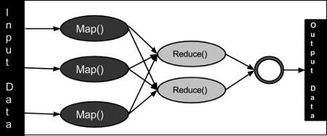
Proposed Work
Statistical Analysis of YouTube data with the help of Hadoop MapReduce Framework

Slide 7
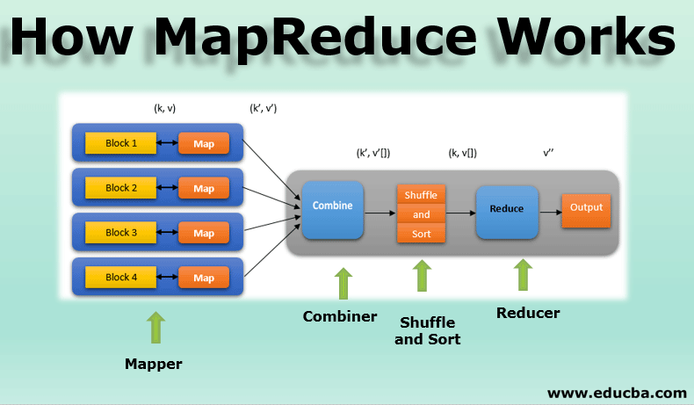
Apache MapReduce Framework
The MapReduce framework has two important functions, namely Map and Reduce. Map takes datasets as input and converts it into another datasets, where datasets are broken down into tuples (key-value pairs).
Generally the input dataset is in the form of file which is stored in the Hadoop file system (HDFS). The input file is passed to the map function. Reduce function, which takes the output from a map as an input and combines those data tuples based on key into a smaller set of tuples, which will be stored in the HDFS.
The Map step performs two sub-steps, splitting & mapping. Split step takes input datasets and divides it into sub-datasets. Mapping step does required computation on sub-datasets.
Output here is (Key, Value) pairs. This output is given to shuffle function which has two sub-steps merge & sort. Map output will be given to merge step which combines all (Key, Value) pairs that have same keys. Output of merge step is given as input to sort step which sorts all (Key, Value) pairs. Finally reduce step takes sorted pairs and reduce it

Slide 8
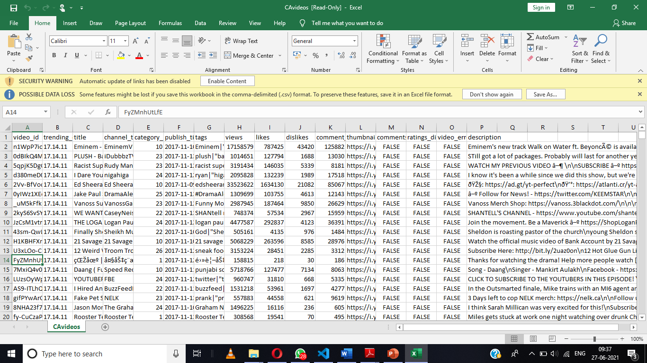
Dataset
We have taken data from the website Kaggle.com and the link ishttps://www.kaggle.com/datasnaek/youtube-new.
As you see , the dataset has various columns like views, likes, dislikes, description, comment, rating channel which gives us a better view of understanding

Slide 9
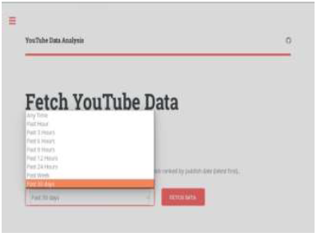
Implementation
Real time YouTube data using YouTube data API is retrieved based on timing frame like any time, past 1/3/6/9/12/24 hours and past 30 days as shown YouTube data is fetched in csv file which is loaded in Hadoop Distributed File System (HDFS) as shown
MapReduce works on key and value pairs. We have taken text variable ‘category’ which will store the category of videos. Variable ‘occurrence’ which is final int value 1. It will be constant for every value. We are storing a single row of csv file in String variable ‘record’. Splitting the row by using comma “,” delimiter as csv file is comma separated values file and storing the values in a string array ‘str’.
If we have the string array ‘str’ of length greater than 5 then we can store the category which is at 4th column in csv file but at index 3 in string array ‘str’. Map method will run once for every row. Mapper output will be category with its occurrence for every row of a csv file.

Slide 10
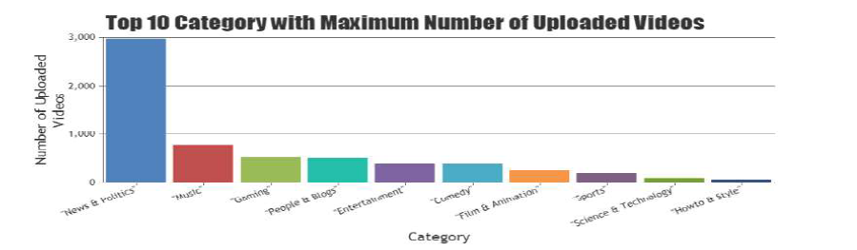
Result Summary

Slide 11
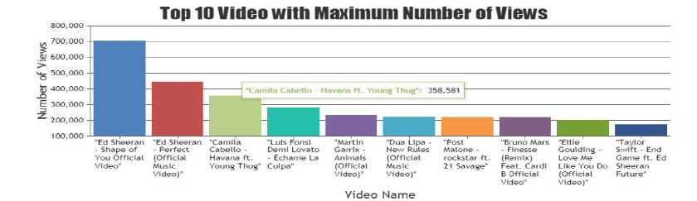
Result Summary

Slide 12

Conclusion
Due to accessibility and availability of Big Data and low-cost of commodity hardware, we have required capabilities for analyzing elephantiac amount of datasets speedily and cost productively. Designed system investigates on YouTube datasets
User can easily examine other channels. Such analytics is built on various parameters like category, channel and views. This system is capable of discovering top 10 categories with maximum no. of uploaded videos, top 10 channels with maximum no. of uploaded videos and top 10 videos with maximum no. of views across YouTube worldwide.
It is also capable of representing these analytical data in demographic form. Designed system will help individuals and various business organizations to get benefited in terms of efficiency, revenue and profitability

Slide 13

Future Work
In future, the designed system can also be implemented on cluster of machines, we have implemented it on a single machine. In this system, we are not analyzing comments posted on a specific video, but one can do sentiment analysis on comments of videos to know feedback of people towards specific videos.

